Slide 1
TAK Server - Data Package Creation from Scratch

Slide 2
TAK Server - Data Package Creation
To create a data package from scratch, we need to first setup the appropriate file structure:
Navigate to the location you intend on storing the data packages and create a new folder named “Auto Enroll Data Package”
Within that “Auto Enroll Data Package” folder, create another folder named “MANIFEST”
Within the “MANFIEST” folder we are going to create a xml document named “manifest.xml”
This can be done by:
Right clicking within the folder, creating a new text document and then change its name
Open a new text editor, save the file with the correct name and in the intended location.

Slide 3

TAK Server - Data Package Pre-requirements
We need to get the immediate trust store for the server and the client certificate, if you aren’t using auto enrollment.
Open a terminal in the server or ssh into the server:
If you need to create the client certificate (as the tak user):
sudo su tak
cd /opt/tak/certs
./makeCert.sh client <name>
Copy the files to the home directory (not as the tak user):
cd ~
sudo cp -v /opt/tak/certs/files/<filename>.p12 .

Slide 4
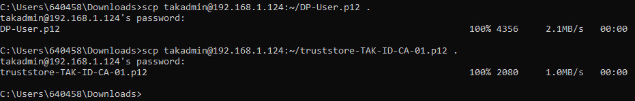
TAK Server - Data Package Pre-requirements
Change the permissions back to the user:
sudo chown -R takadmin:takadmin /home/takadmin
Open a terminal on your local machine and copy over the files using the following:
scp <username>@<IP Address>:~/<filename>.p12 .
These files will need to go into the “Auto Enroll Data Package” folder:
You can navigate the command line to the destination of the folder then download it there.
You can download the files then move/copy them over to the location.

Slide 5
TAK Server - Data Package Creation
Manifest break down:
Configuration:
uid: the uid for the data package helps identify it if the name is changed when sent from person to person. If the uid is not supplied, a hash is generated and used to determine if the file is unique.
name: the name of the data package for display to the end user.
onReceiverDelete: determines in the data package should be deleted as soon as the import is finished. This is ideal for staging devices.
Contents:
Content: the name of the file in the data package. If the ignore flag is set to true, the file is not passed into the import manager.
Zip entry: the standard Zip Entry path
Ignore: If true the zip entry is not extracted during import and is not listed in the mission package tool UI.
Open the “manifest.xml” file with a text editor, copy the information on the next slide and change the highlighted parts to fit your deployment:
Notes:
# The following example is creating a data package for a specific client for a TAK Server Deployment.
# You can change the uid if desired

Slide 6
TAK Server - Data Package Creation
<MissionPackageManifest version="2">
<Configuration>
<Parameter name=“uid” value=“a647112f-ce05-4312-a2b4-208d8d8a5fa8”/>
<Parameter name="name" value="DP-TAK-Server.zip"/>
<Parameter name="onReceiveDelete" value="true"/>
</Configuration>
<Contents>
<Content ignore="false" zipEntry="config.pref"/>
<Content ignore="false" zipEntry="truststore-TAK-ID-CA-01.p12"/>
<Content ignore-"false" zipEntry="DP-User.p12"/>
</Contents>
</MissionPackageManfiest>
The grey highlighted section is the uid of the data package which can be used or changed to a unique one.
You can run uuidgen in the command line to generate one.
The yellow highlighted section is the name you want for the data package.
The green highlighted section is the name of the truststore file you download from the TAK Server.
The blue highlighted section is the name of the client certificate you download from the TAK Server.
If you are using autoenrollment you do not need to include the client certificate.
When done, save the changes.

Slide 7
TAK Server - Data Package Creation
Navigate back to the “Auto Enroll Data Package” folder.
Create a new file named “config.pref” and open it with a text editor and fill with the contents on the next slide. Do not forget to update the highlighted sections.
Notes:
# Note: if you would like to change the name of the config file you will also need to update it in the manifest.xml file.

Slide 8
TAK Server - Data Package Creation - With Client Certificate
<?xml version='1.0' standalone='yes'?>
<preferences>
<preference version="1" name="cot_streams">
<entry key="count" class="class java.lang.Integer">1</entry>
<entry key="description0" class="class java.lang.String">DP-TAK-Server</entry>
<entry key="enabled0" class="class java.lang.Boolean">true</entry>
<entry key="connectString0" class="class java.lang.String">192.168.1.124:8089:ssl</entry>
<entry key="caLocation0" class="class java.lang.String">cert/truststore-TAK-ID-CA-01.p12</entry>
<entry key="certificateLocation0" class="class java.lang.String">cert/DP-User.p12</entry>
<entry key="clientPassword0" class="class java.lang.String">atakatak</entry>
<entry key="caPassword0" class="class java.lang.String">atakatak</entry>
</preference>
<preference version="1" name="com.atakmap.app_preferences">
</preference>
</preferences>
The yellow section is the display name of the server on the client's end.
The green section is the IP address of the server, alternatively you can use the public facing domain name if setup.
The blue sections are the information for the CA certificate.
The red sections are the information for the client certifiacte.

Slide 9
TAK Server - Data Package Creation -Autoenrollment
<?xml version='1.0' standalone='yes'?>
<preferences>
<preference version="1" name="cot_streams">
<entry key="count" class="class java.lang.Integer">1</entry>
<entry key="description0" class="class java.lang.String">DP-TAK-Server</entry>
<entry key="enabled0" class="class java.lang.Boolean">true</entry>
<entry key="connectString0" class="class java.lang.String">192.168.1.124:8089:ssl</entry>
<entry key="caLocation0" class="class java.lang.String">cert/truststore-TAK-ID-CA-01.p12</entry>
<entry key="caPassword0" class="class java.lang.String">atakatak</entry>
<entry key="enrollForCertificateWithTrust0" class="class java.lang.Boolean">true</entry>
<entry key="useAuth0" class="class java.lang.Boolean">true</entry>
<entry key="cacheCreds0" class="class java.lang.String">Cache credentials</entry>
</preference>
<preference version="1" name="com.atakmap.app_preferences">
</preference>
</preferences>
The yellow section is the display name of the server on the client's end.
The green section is the IP address of the server, alternatively you can use the public facing domain name if setup.
The blue sections are the information for the CA certificate.
The grey sections are optional additions but are recommend.

Slide 10
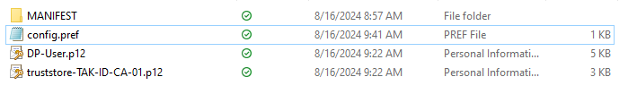
TAK Server - Data Package Creation
From the “Auto Enroll Data Package” select the following content and zip them:
MANIFEST directory
config.pref file
CA.p12 file
Example: truststore-TAK-ID-CA-01.p12
Client.p12 file
If you are using autoenrollment you can skip this one.
Example: DP-User.p12
After zipping them change the name of the zip file to the intended one.
This will need to be the same one you added in the “manifest.xml” file.

Slide 11
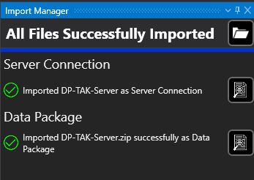
TAK Server - Deploying Data Package
Either drag and drop the zip file into the TAK deployment or import the data package.
If done correctly you will see the following after importing it:
You can also verify the connection to the server was successful by locating the green cloud icon at the bottom right of the map.

Slide 12
TAK Server - Data Package - Manifest
Manifest optional parameters:
onReceiveDelete (boolean): Omit or false to have mission packages persist on receiver, if true the zip will automatically be deleted after extraction on the receiver.
onReceiveImport (boolean): to have the mission package imported on receiver, if true, the mission package zip will be automatically imported. If false, the data will be extracted but not imported.
This is not processed for locally imported package but only for packages received over the network. (Sent by another ATAK user)
onReceiveAction (string): action which ATAK uses to broadcast an intent upon receiving a mission package.
ATAK includes the file transfer details and mission package manifest as intent extras. This allows tools to include custom configuration parameters which are delivered to the receiver component.
Note: if onReceiverDelete is specified, the mission package is deleted prior to instantiating and broadcasting this intent.

Slide 13
Resources
Data package tool integration: https://wiki.tak.gov/display/DEV/Data+Package+Format?preview=/8323647/32048030/Data%20Package%20Tool%20Integration.pdf

